Slide 1





Ions & Ionic Bonding
Unit 2
Lesson 3
Na
1 electron
Cl
Na⁺
Cl⁻
Mg
2 electrons
O
Mg²⁺
O²⁻

Slide 2
Starter: electronic configuration test
Using a mini whiteboard, draw the electronic configuration of the following atoms.
Keep your answer to yourself, and only show your whiteboard when the teacher says.
oxygen
carbon
potassium
nitrogen

Slide 3
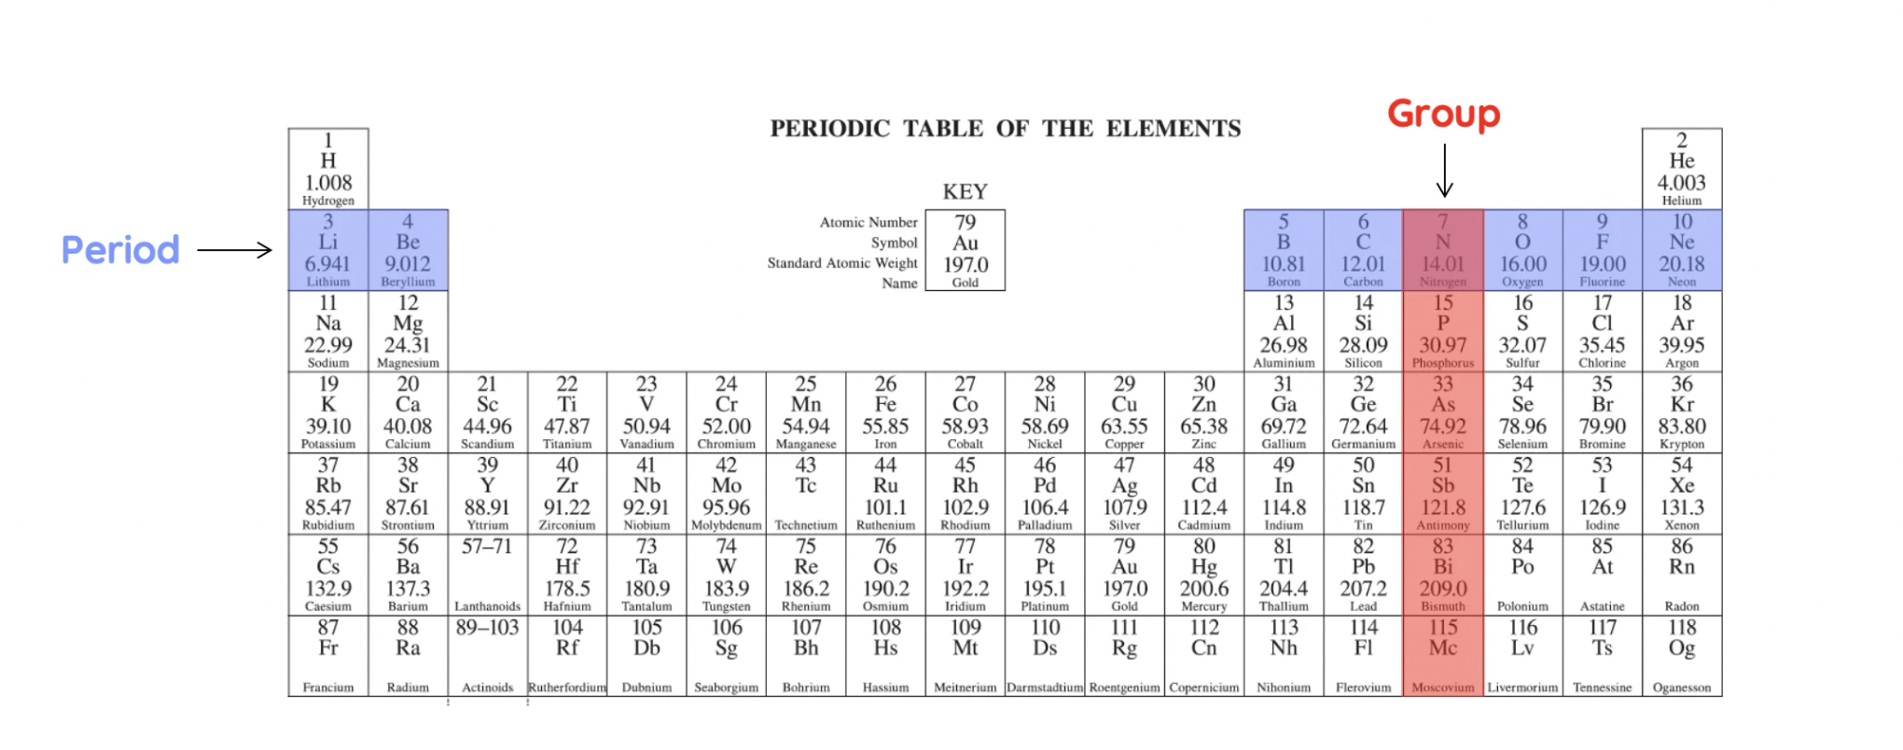
Starter: electronic configuration test
Valence Electrons
1
8
2
3
4
5
6
7

Slide 4
Today’s Aim
Unit 2
Lesson 3
By the end of this lesson I will be able to
draw dot cross diagrams to show the formation of ionic bonds
deduce the ionic formula for different compounds

Slide 5

Watch this video about atoms forming ions

Slide 6
A general rule
Metals usually form positive ions
Metal atoms tend to lose electrons to form cations.
Non-metals usually form negative ions
Non-metal atoms tend to gain electrons to form anions.

Slide 7
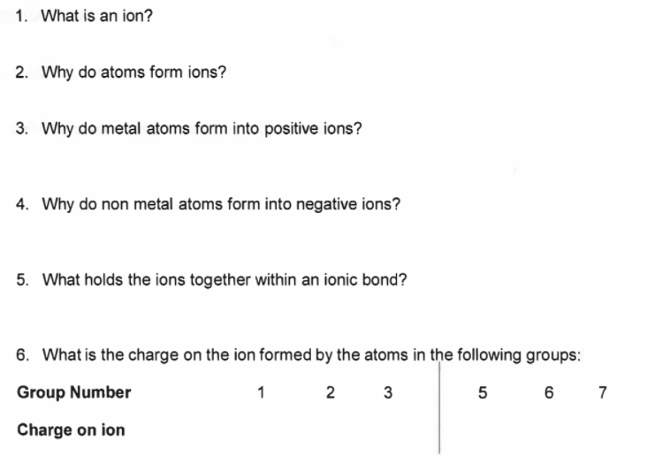
Answer these questions on page 16
An atom (or group of atoms) with a positive or negative charge.
Ions form when an atom gains or loses electrons.
Metals lose electrons and so become positive
Nonmetals gain electrons and so become negative
Electrostatic force - positive and negative charge attracting
1+ 2+ 3+
3- 2- 1-

Slide 8
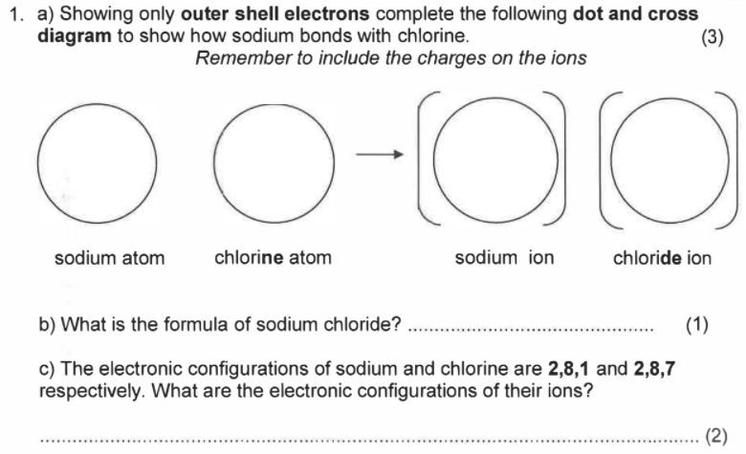
Answer question 1 on page 17
X
X
X
+
–
X
X
Cl
Na
Cl
X
Na
X
X
X
X
NaCl
Na⁺ = [2,8]⁺ Cl– = [2,8,8]–

Slide 9



sodium + chlorine → sodium chloride
-
+
Na
Cl
For clarity, only outer electrons are usually presented.

Slide 10

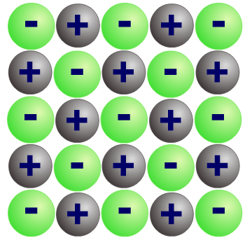
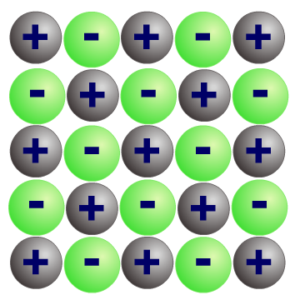
Ionic Bonding
Compounds that contain ions are called ionic compounds.
These compounds are usually formed by a reaction between a metal and a non-metal.
Electrons are transferred from each metal atom to each non-metal atom. The metal and the non-metal atoms form ions with full outer shells.
The positive and negative ions are strongly attracted to each other. This strong electrostatic force of attraction is called ionic bonding.

Slide 11
Ratio of ions
Sodium chloride (NaCl) and magnesium oxide (MgO) are ionic compounds.
In each compound, the metal needs to lose the same number of electrons that the non-metal needs to gain.
Na
1 electron
Cl
Na⁺
Cl⁻
Mg
2 electrons
O
Mg²⁺
O²⁻
Both compounds have a 1:1 ratio of metal ions to non-metal ions, which is shown by the formula of each compound.

Slide 12
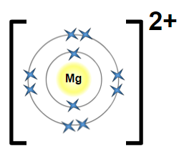
Magnesium oxide (MgO)
2-
O

Slide 13
Sodium oxide
Sodium (2.8.1) needs to lose 1 electron to form a sodium ion but oxygen (2.6) must gain 2 electrons to form an oxide ion .
Na
Na⁺
1 electron from each Na atom
O²⁻
O
Na
Na⁺
Two sodium atoms are required for each oxygen atom and so the ratio of sodium ions to oxide ions is 2:1.
From this ratio, the formula of sodium oxide is Na₂O.

Slide 14
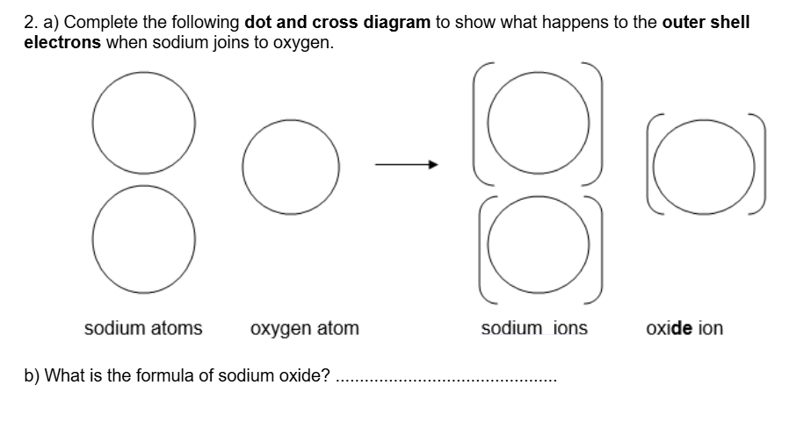
Question 2 on pages 17 and 18
X
X
+
X
X
X
2–
Na
X
Na
X
X
O
O
X
X
X
X
X
+
Na
X
X
X
X
Na
X
X
X
Na₂O

Slide 15
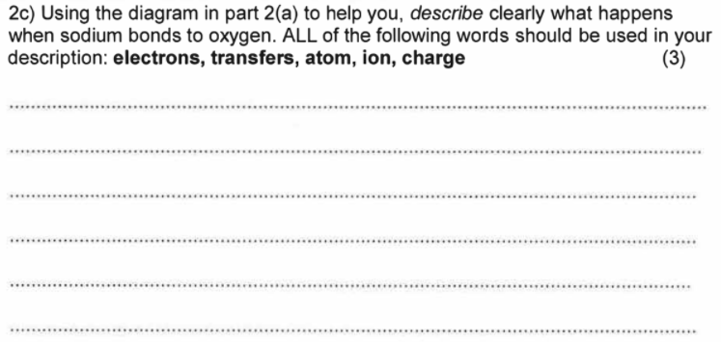
Question 2 on page 18
Two atoms are sodium are needed for every one atom of oxygen.
Each sodium atom loses one electron. The sodium atoms become sodium ions: Na → Na⁺
These electrons are transferred to the oxygen atom.
The oxygen atom gains two electrons to become an oxide ion: O → O²⁻
There is now and electrostatic force of attraction between the charged particles.

Slide 16
sodium oxide (Na₂O)
+
Na
2-
+
O
Na

Slide 17
magnesium chloride
Magnesium (2.8.2) needs to lose 2 electrons to form a magnesium ion but chlorine (2.8.7) needs to gain 1 electron to form an chloride ion.
Cl
Cl⁻
1 electron
for each
Cl atom
Mg
Mg²⁺
Cl⁻
Cl
Two chlorine atoms are required for each magnesium atom and so the ratio of magnesium ions to chloride ions is 1:2.
From this ratio, the formula of magnesium chloride is MgCl₂.

Slide 18
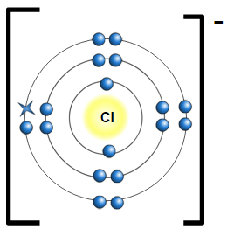
magnesium chloride, MgCl₂
-
2+
Mg
-

Slide 19
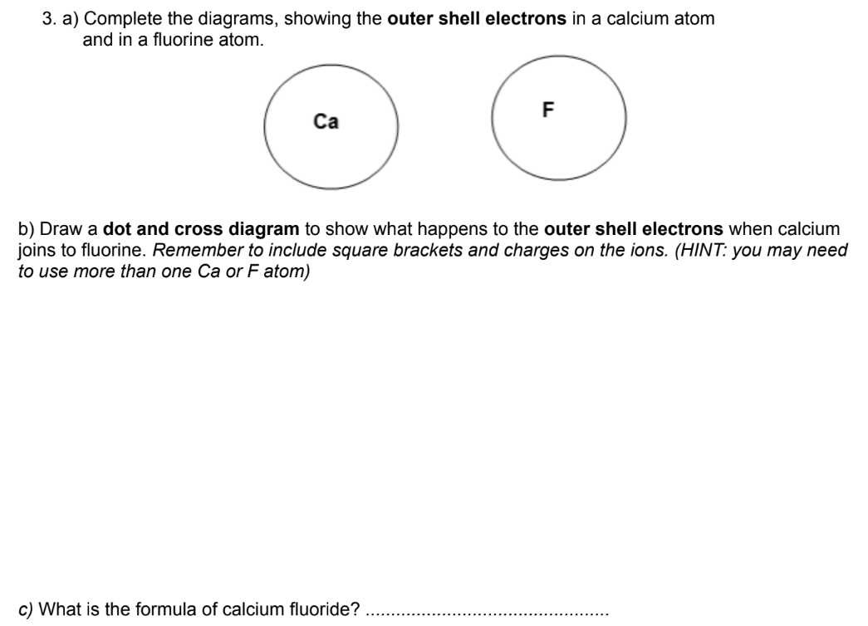
Answer questions 3 & 4 on page 18

Slide 20
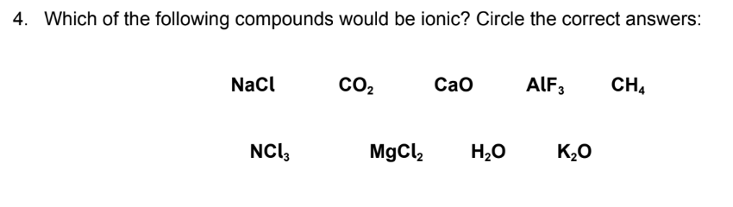
Question 4 on page 18
For ionic bonding to take place, both a positive and negative ion are needed. This means that most ionic compounds are formed from a metal ion and a non-metal ion

Slide 21
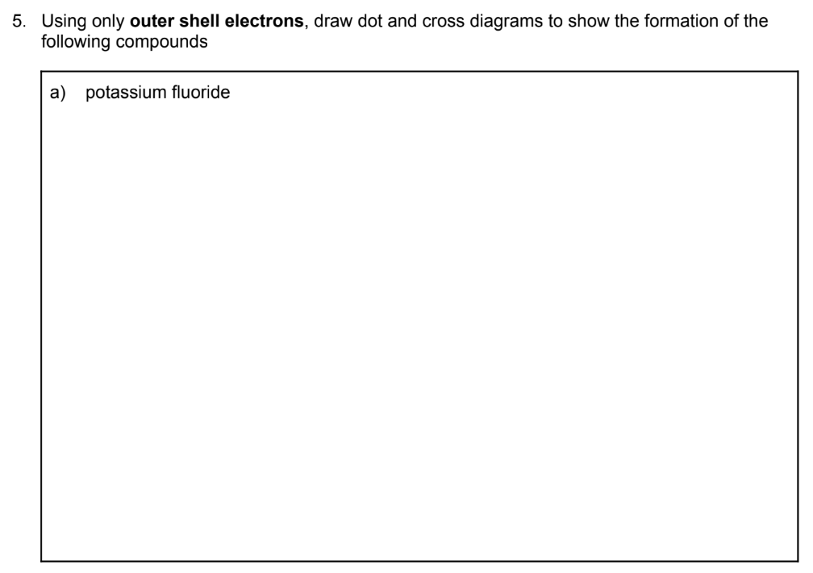
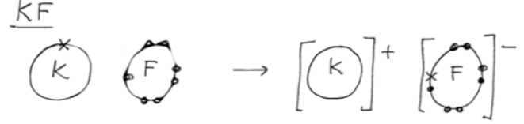
Question 5a on page 19

Slide 22
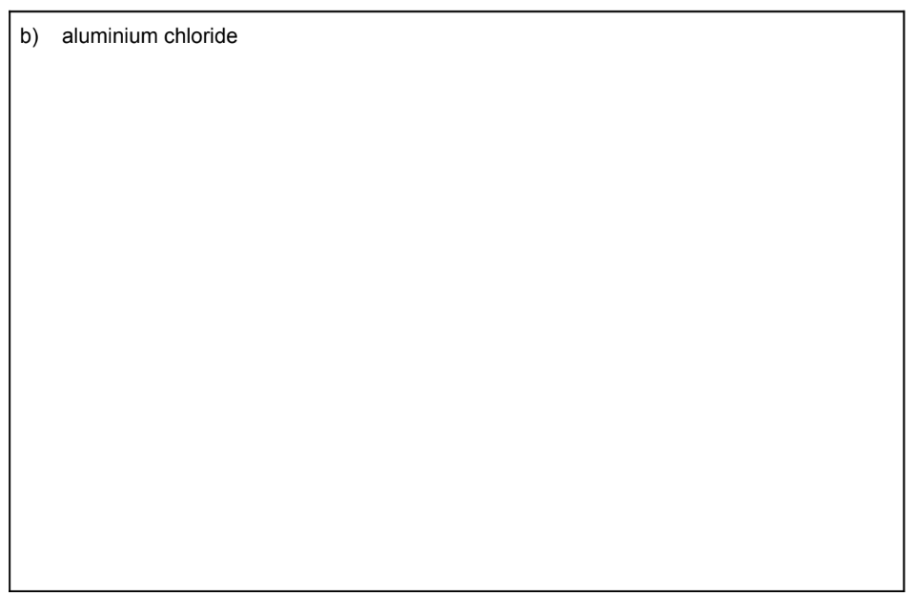
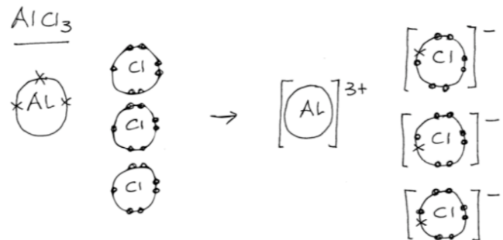
Question 5b on page 19

Slide 23


aluminium chloride
Symbol
Al
Cl
Ion charge
+3
-1
Balance the number of ions
3 chloride ions are needed for each aluminium ion
Ratio of ions
1 : 3
Formula
AlCl₃
Cl
Cl–
1 electron
for each chlorine atom
Al
Cl
Al³⁺
Cl–
Cl
Cl–

Slide 24
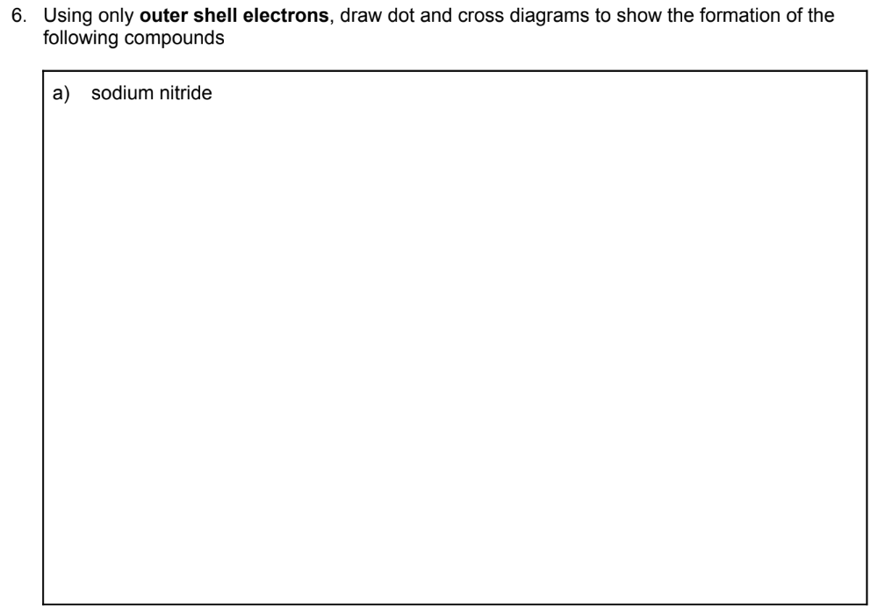
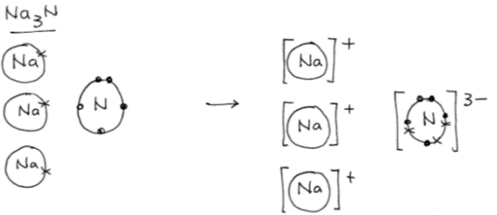
Question 6a on page 20

Slide 25
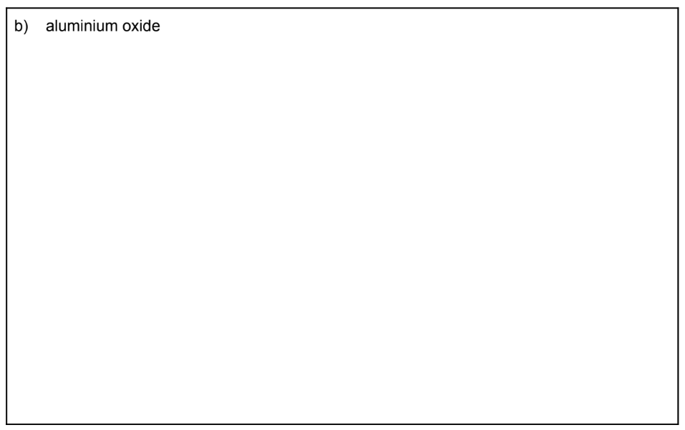
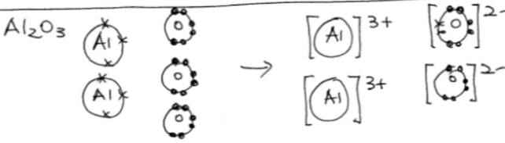
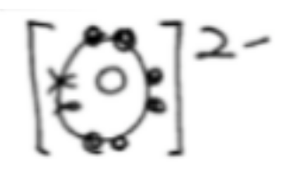
Question 6b on page 20

Slide 26
Formula of aluminium oxide
aluminium oxide
Symbol
Al
O
Ion charge
+3
-2
Balance the number of ions
2 aluminium ions are needed for 3 oxide ions
Ratio of ions
2 : 3
Formula
Al₂O₃
O
O²⁻
Al
Al³⁺
2 electrons for each oxygen atom
O²⁻
O
Al³⁺
Al
O
O²⁻

Slide 27
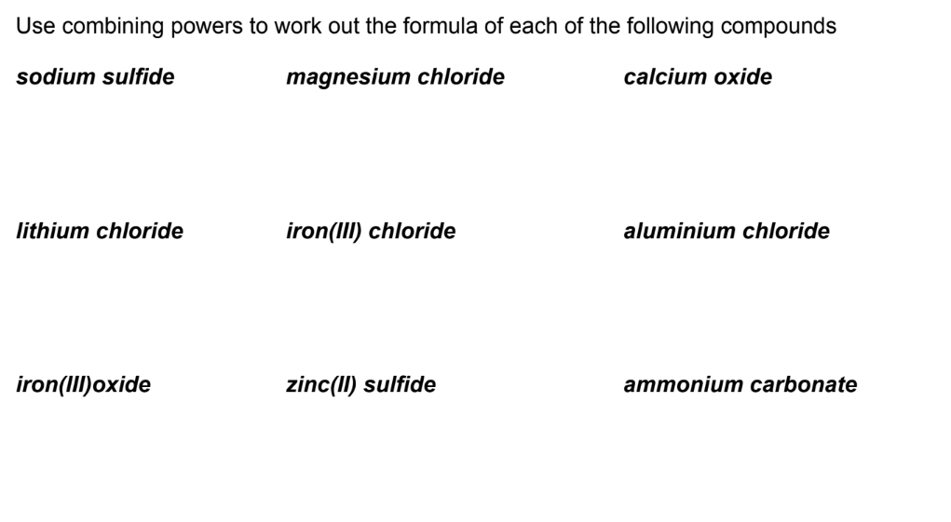
Ionic formulae (page 22)
Na₂SO₄
MgCl₂
CaO
LiCl
FeCl₃
AlCl₃
Fe₂O₃
ZnS
(NH₄)₂CO₃

Slide 28
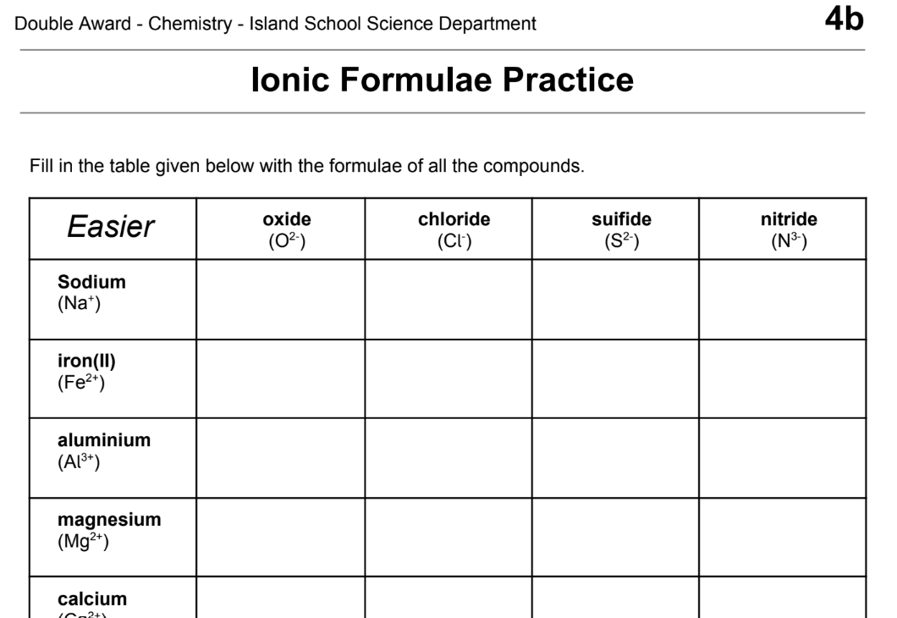
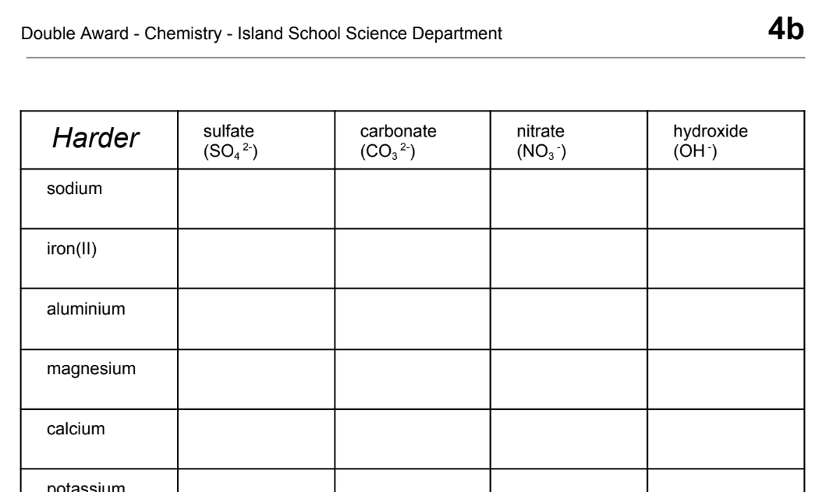
Plenary: writing ionic formula
What are the formulae of the ionic compounds from different combinations of cations and anions?
Page 23
Page 24

Slide 29

What you need to know
Unit 2
Lesson 3
Syllabus Content
1.40
draw dot-and-cross diagrams to show the formation of ionic compounds by electron transfer, limited to combinations of elements from Groups 1, 2, 3 and 5, 6, 7.
1.41
understand ionic bonding in terms of electrostatic attractions.
My Learning

